Slide 1
Coding your First Smart Contract on the Ethereum Blockchain

Slide 2
A quick overview of the workshop
The basics: Blockchain, smart-contracts, Ethereum accounts, Ethereum networks, Solidity…
Our first smart-contract on Remix
Setting up the development environment
Setup and configuration of our first smart-contract project
The basics of Solidity
A more advanced smart-contract - lottery on the blockchain

Slide 3
A quick overview of the workshop 2/2
Smart-contract compilation
Smart-contract deployment using Infura
Testing our smart-contract with Mocha
A very simple DAPP - interacting with our smart-contract from a web fronted using web3
Resources: https://github.com/ETHSC/Ethereum-Smart-Contract-Workshop

Slide 4
Let's get started with the basics…
The Ethereum network
Interacting with anEthereum Networks
Different types of ethereum accounts
Transactions, Either, Wei and Gas
Smart-contracts
The Solidity programming language

Slide 5
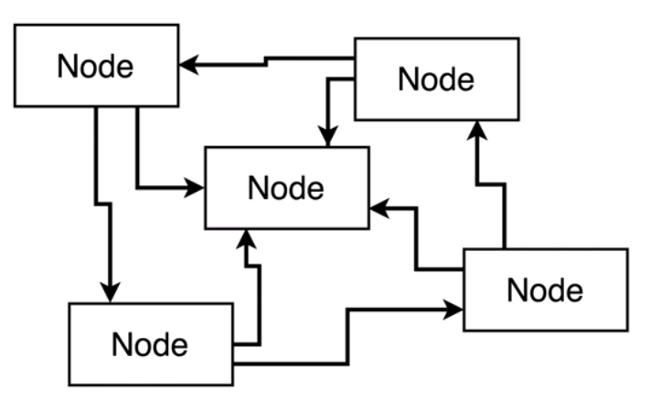
An Ethereum network
Used transfer money (ether) and store data
There are different types of Ethereum networks
Network consists of one or more nodes
A node is a machine running an Ethereum client
A node can contain a copy of the entire blockchain
Blockchain = database that stores a record of
every transaction that has ever taken place

Slide 6
Interacting with an Ethereum Networks
Developers use web3.js to call smart contract functions
Consumers can use Metamask or any other DAPP
to make transactions…

Slide 7
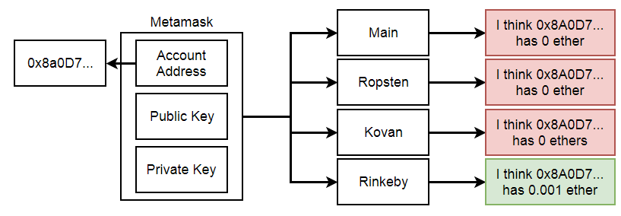
Ethereum accounts

Slide 8
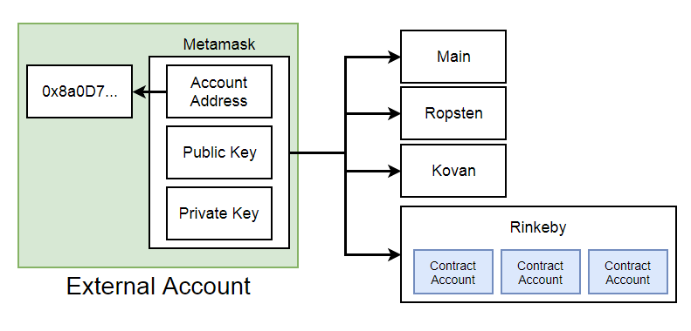
Types of Ethereum Accounts

Slide 9
Transactions, Ether, Wei and Gas
Transactions: To, value, gasPrice, gasLimit, v, r, s
gasPrice: Price in Wei (1 ETH == 10^18 Wei) per unit of gas the
sender is willing to pay to get a transaction processed
gasLimit: Maximum amount of gas this transaction is allowed to consume

Slide 10
Smart Contracts
Smart Contract: Account controlled by code
Smart Contract properties:
  Balance
  data storage
  contract byte code
Each deployment creates a new instance of your smart contract

Slide 11
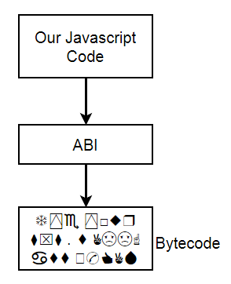
The Solidity Programming Language
Written in .sol files
Strongly typed
Syntax looks similar to Javascript
Smart Contract compilation generates: Byte code + ABI

Slide 12
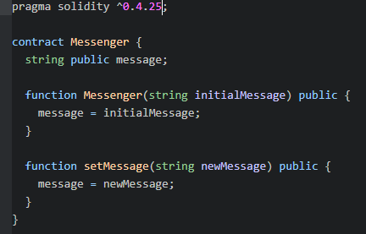
Structure of a very basic Smart Contract
Specification of the Solidity version
of our code
Contract definition
Instance variables and their types
Contract functions

Slide 13
Hello World - our first smart-contract
Writing, compiling, deploying, testing, debugging… our smart-contract
on Remix in 10 minutes: http://remix.ethereum.org
Selecting the environment: In-memory javascript VM or injected
Web3 (from MetaMask)
Selecting a test account and providing other required parameters
Deploying our contract or loading an already deployed contract
from a specific address
Testing and playing around with our smart-contract
Debugging on Remix

Slide 14
Setting up our development environment
Remix does everything - why bother with a local environment?
Installing Node.js: https://nodejs.org/en/download
Installing Git: https://git-scm.com/downloads
Installing an editor - Atom: https://atom.io + language-ethereum
Installing and configuring the MetaMask Chrome/Firefox plugin
  Selecting a public or private network
  Creating/Importing an account
  Account info on Etherscan
  Getting free test Ether on Rinkeby Faucet

Slide 15
Creating our first smart-contract project
Setting up our project: npm init - creates a package.json file
Project structure: ethereum/contracts folder, test folder
Installing a few basic npm modules:
npm install --save solc mocha ganache-cli truffle-hdwallet-provider@0.0.3 web3
Or, download the project from github and execute npm install in the project directory

Slide 16
More on Solidity
Docs: https://solidity.readthedocs.io/en/v0.4.24
Value types: bool, int, uint8, int256, fixed…
Address: holds 20 byte value - members: balance, transfer
Reference types: Arrays, struct, mapping
uint[] memory a = new uint[](5);
mapping(address => uint) public balances;

Slide 17
More on Solidity 2/2
Modifiers - check a specific condition prior to executing a function
The msg object: sender, value, gas…
Transferring ether: address.transfer(amount)
Function keywords: public, payable, view, returns
State changes and gas cost

Slide 18
A more advanced smart-contract
lottery on the blockchain
Contract manager and players
Entering the lottery with a specific amount
Everyone can consult the current number of players
Picking a winner - can only be executed by the contract manager

Slide 19
Compiling and deploying a smart-contract
A simple compilation script: node compile.js
Bytecode and ABI (Application Binary Interface)
A simple deployment script: node deploy.js
Connecting to your wallet (MetaMask, Ganache…) using web3
and the truffle-hdwallet-provider

Slide 20
Testing your smart-contract with Mocha
Mocha: https://mochajs.org/
Deploying our smart-contract locally with ganache-cli
Executing a code block before each test: beforeEach()
Defining a group of test cases: describe()
Defining a single test case: it()
The assert library: assert.equal(1, players.length); …

Slide 21
DAPP's - Creating the project
Creating boiler-plate React apps: npm install -g create-react-app
Creating a new project: create-react-app lottery-web
Installing some packages: npm install --save web3
Or: Download the app from github, open a cmd window, navigate to the project directory and execute: npm install (this installs all required npm modules)
Running the app: npm run start

Slide 22
Interacting with your smart-contract from JS
Connecting the web3 provider that was injected by MetaMask with our own web3 component: const web3 = new Web3(window.web3.currentProvider);
Copy/paste contract address and ABI after smart-contract compilation
Calling a smart-contract method:
const manager = await lottery.methods.manager().call();
Getting the contract address: const contrAddr = await lottery.options.address;

Slide 23
Interacting with your smart-contract 2/2
Getting the list of accounts: const accounts = await web3.eth.getAccounts();
Getting the contract balance:
const balance = await web3.eth.getBalance(lottery.options.address);
Sending ether in a transaction:
await lottery.methods.enter().send({from: accounts[0],
value: web3.utils.toWei(this.state.value, 'ether') })
Converting from wei to ether: web3.utils.fromWei(this.state.balance, 'ether')

Slide 24
Playing around with your smart-contract
Make some modifications to your smart-contract code
Re-compile, deploy, run and test your modified contract
Add a new function to your smart-contract
Debug your smart contract in Remix

Slide 25
Step-by-step docs and References
Step-By-Step Environment Setup.docx
Step-By-Step Project Setup.docx
Step-By-Step Compiling Deploying Running a Project.docx
Useful References.docx

